Slide 2
Step by Step: .NET Microservices
Using Kubernetes, RabbitMQ & Grpc
Episode 3 – Season 4

Slide 3
This course will
Focus on the Technical aspects of building .NET Microservices
Cover theory as we go
Take a pragmatic / balanced approach (but follow best practices)
Be fully step by step – that’s why it’s long!
Be as practical and interesting as possible
Acknowledge that Microservices are hard!

Slide 4
This course does not…
Focus on Domain Driven Design, Bounded Contexts etc.
Build out redundant “business logic” – our use case is simple
Demonize the Monolith / band-wagon jump
Cover EVERYTHING… there was a balance to be struck

Slide 5
What we’ll cover (& what you’ll learn)
INTRO & THEORY
Course Overview
Pre requisites
Ingredients / Tooling
What are Microservices?
Our Services
Solution Architecture
Service Architecture
STARTING THE PLATFORM SERVICE
Overview
Scaffolding
Data Layer
Controller and & Actions
DOCKER & KUBERNETES
Review of Docker
Containerize Platform Service
Pushing to Docker Hub
Intro to Kubernetes
Kubernetes Architecture
Deploy Platform Service
External Network Access

Slide 6
What we’ll cover (& what you’ll learn)
STARTING THE COMMANDS SERVICE
Scaffolding
Controller & Action
Synchronous & Asynchronous Messaging
Adding a HTTP Client
Deploy service to Kubernetes
Internal Networking
API Gateway
SQL SERVER
Persistent Volume Claims
Kubernetes Secrets
Deploy SQL Server to Kubernetes
Revisit Platform Service
MULTI-RESOURCE API
Review of Endpoints for Commands Service
Data Layer
Controllers & Actions

Slide 7
What we’ll cover (& what you’ll learn)
MESSAGE BUS / RABBITMQ
Solution Architecture Review
RabbitMQ Overview
Deploy RabbitMQ to Kubernetes
Test
ASYNCHRONOUS MESSAGEING
Adding a Message Bus Publisher to Platform Service
Event Processing
Adding an Event Listener to the Commands Service
GRPC
Overview of GRPC
Final Kubernetes networking
Adding gRPC server to Platforms service
Creating a “proto” file
Adding a gRPC client to the Commands service
Deploy & Test

Slide 8
Prerequisites
We will do everything step by step here, but:
Experience with building .NET (Core) REST APIs in C#
Understanding of Docker & associated concepts
Dependency Injection in C#
Use of Async / Await
Would be useful!

Slide 9
Want to know more about .NET REST APIs?
Over 450 Pages, covering:
REST Theory
API Build
Unit Testing
Azure DevOps
Deploy to Azure

Slide 10
Ingredients
VS Code Text Editor (free)
.NET 5 (free)
Docker Desktop (Running Kubernetes) (free)
An account on Docker Hub (free)
Insomnia or Postman (free)
A “decent” level of local hardware (not usually free)

Slide 11
My PC Spec
We’ll be spinning up a lot of containers (in Kubernetes)
Intel i7
32Gb Memory
16Gb will be fine
Less than 8Gb and you’ll start to struggle
1TB SSD

Slide 12
Free Kubernetes Cheat Sheet
Docker & Kubernetes Commands
Kubernetes Application Architecture Reference
Kubernetes Object Glossary
Go to: https://dotnetplaybook.com/
Subscribe & we’ll email you with a download link

Slide 13
Other course resources
Code is available on GitHub
Course Outline in description
Jump to / revisit sections
Course Slides – (Patreon $5 supporters)
patreon.com/binarythistle

Slide 14

Microservices
What are they and how are they saving the world?

Slide 15
The Single Responsibility Principle
“Gather together those things that change for the same reason, and separate those things that change for different reasons.”
Robert C. Martin

Slide 16
What are “Microservices”
Small (2 pizza team, 2 weeks to build)
Responsible for doing 1 thing well
Organisationally aligned
Form part of the (distributed) whole
Self-contained / Autonomous

Slide 17

A True Story…
I know of large monolithic CRM system, that:
Services millions of customs
Evolved over many years
Built on a single, proprietary tech stack
Managed by 1 “out-sourced” partner

Slide 18
This system is…
Very difficult to “change”
Change cycles are months in duration
Massive amounts of (frequently manual) testing
Difficult to Scale
Locked in
Technology terms
Intellectual Property terms (an external party held the cards)

Slide 19
Benefits of Microservices
Easier to change & deploy (small and decoupled)
Can be built using different technologies
Increased organisational ownership & alignment
Resilient: 1 service can break the, others will continue to run
Scalable: You can scale out only the services you need to
Built to be highly replaceable / swappable

Slide 20



An Example
X
X
Flight Catalog
(.Net)
Booking
(Ruby on Rails)
Check in
(Node)
Instance 1
Instance 1
Instance 1
Instance 2
Instance 2
SQL Server
PostgreSQL
MongoDB
Team: Nessie
Country: Scotland
Team: The Eagles
Country: USA
Team: Cobra
Country: India

Slide 21

So..?
Microservices
Monoliths

Slide 22
Microservices
Monoliths
Are difficult to implement
Can result in “analysis paralysis”
Need strong domain knowledge
Distributed – shock horror the network can fail
Paradoxically will always be coupled to something…
Simpler to implement
Can use CI/CD, daily deploys, small changes etc.
Allow you to familiarise yourself with the domain
Can have 2 or 3 “big” services
Not as reliant on network

Slide 23
Our Services

Slide 24

The “Platform” Service
Function as an “Asset Register”
Track all the platforms / systems in the company
Built by the Infrastructure Team
Used by:
Infrastructure Team
Technical Support Team
Engineering
Accounting
Procurement

Slide 25

The “Commands” Service
Function as a repository of command line augments for given Platforms
Aid in the automation of support processes
Built by the Technical Support Team
Used By:
Technical Support Team
Infrastructure Team
Engineering

Slide 26
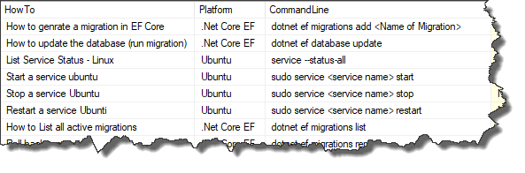
Solution Architecture
Internal Microservices Domain
Platform
Service
SQL
Server
xyz
Service
SQL
Server
REST API
Http
Grpc
Pub.
Sub.
Pub.
“API Gateway”
RabbitMQ Message Bus
Grpc
Sub.
Pub.
Command
Service
In Mem
abc
Service
SQL
Server
REST API

Slide 27
Platform Service Architecture
HTTP Request
Grpc Service (Synchronous - in)
HTTP Client (Synchronous - out)
HTTP Response
HTTP Request
Controller (Synchronous - in)
Msg. Publisher (Asynchronous - out)
HTTP Response
Publish to
Message Bus
DTOs
Repository
Mapped
Read/
Write
Models
DB Context
SQL Sever DB

Slide 28
Command Service Architecture
HTTP Request
Controller (Synchronous - in)
Grpc Client (Synchronous - out)
HTTP Response
Msg. Subscriber (Asynchronous - in)
Received from
Message Bus
DTOs
Repository
Mapped
Read/
Write
Models
DB Context
SQL Sever DB

Slide 29
Start Coding!
Platform Service

Slide 30
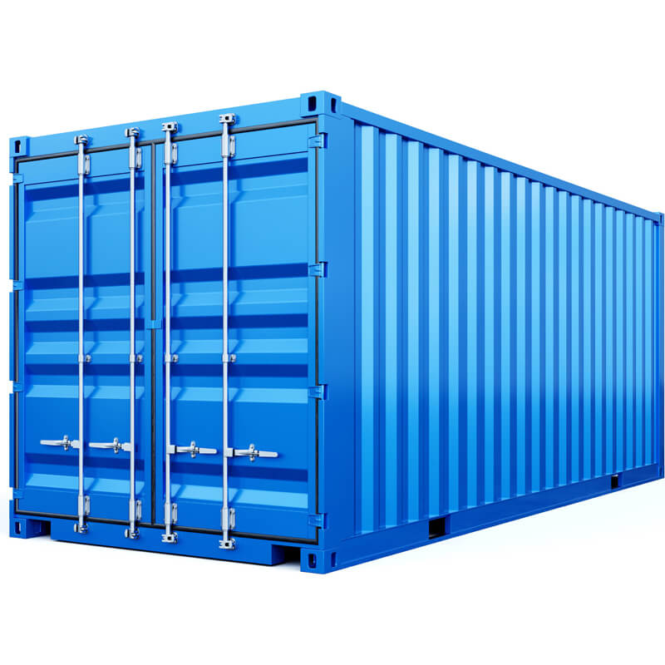
Docker
A Quick Review

Slide 31
What is Docker?
Docker is a containerization platform, meaning that it enables you to package your applications into images and run them as “containers” on any platform that can run Docker.

Slide 32
App 1
App 2
App 1
App 2
App 1
App 2
OS
OS
Hypervisor
Docker
Operating System
Operating System
Operating System
Physical Machine
Virtual Machine
(OS Virtualisation)
Container (Docker)
(App Virtualisation)
Key:
Virtual Machine
Container

Slide 33

Dockerfile
Docker
Image
Docker
Engine

Slide 34

Kubernetes
An Introduction

Slide 35

Kubernetes
Container
Container
Container

Slide 36
Kubernetes
Built by Google now maintained by the Cloud Native Foundation
Often referred to as “K8S”
Container Orchestrator
Huge subject area!
2 broad user profiles
Developer
Administrator

Slide 37
Kubernetes Architecture
Cluster
Node
Node Port
Pod
Pod
Pod
3xxxx
80
Platform
Service
Container
Platform SQL Server
Container
RabbitMQ
Container
80
666
1433
5672
15672
80
666
1433
5672
15672
Cluster IP
Cluster IP
Cluster IP
Pod
Pod
Ingress Nginx
Container
Command Service
Container
Ingress Nginx
Load Balancer
Persistent Volume Claim
80
80
80
80
Cluster IP
Kubernetes (Docker Desktop)
Container Runtime (Docker)
Operating System (Windows 10 with WSL2)
Hardware (PC)

Slide 38

Multi-Resources URIs

Slide 39
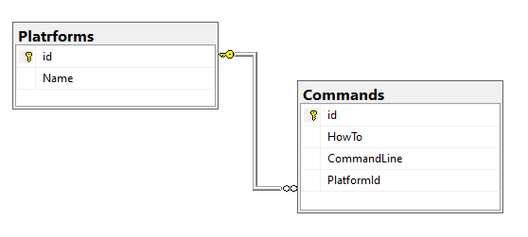
Working with Command Resources
Platform is the “parent”
We get to commands via their platform
Action | Verb |  | Controller
Get all Platforms | GET | /api/c/platforms | Platform
Get all Commands for a Platform | GET | /api/c/platforms/{platformId}/commands | Command
Get a Command for a Platform | GET | /api/c/platforms/{platformId}/commands/{commandId} | Command
Create a Command for a Platform | POST | /api/c/platforms/{platformId}/commands/ | Command

Slide 40

Messaging
Synchronous & Asynchronous Messaging

Slide 41
Synchronous Messaging
Request / Response Cycle
Requester will “wait” for response
Externally facing services usually synchronous (e.g. http requests)
Services usually need to “know” about each other
We are using 2 forms:
Http
Grpc
Notes:
Include the Synchronous chain of calls

Slide 42
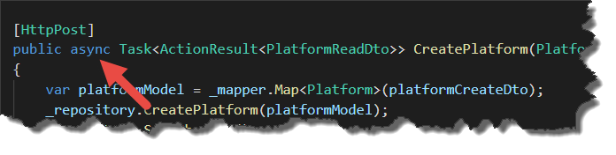
Wait! What if I mark http actions as Async?
From a messaging perspective this method is still synchronous
The client still has to wait for a response
Async in this context (the C# language) means that the action will not wait for a long running operation
It will hand back it’s thread to the thread pool, where it can be reused
When the operation finishes it will re-acquire a thread and complete, (and respond back to the requestor)
So Async here is about thread exhaustion – the requestor still has to wait (the call is synchronous)
Notes:
Include the Synchronous chain of calls

Slide 43
Synchronous messaging between services
Can and does occur – we will implement, however..
It does tend to pair services, (couple them), creating a dependency
Could lead to long dependency chains
Service A
Service C
Service B
Service D
Service E
Notes:
Include the Synchronous chain of calls

Slide 44
Asynchronous Messaging
No Request / Response Cycle
Requester does not wait
Event model, e.g. publish –subscribe
Typically used between services
Event bus is often used (we’ll be using RabbitMQ)
Services don’t need to know about each other, just the bus
Introduces its own range of complexities – not a magic bullet
Notes:
Include the Synchronous chain of calls

Slide 45
Wait! Isn’t the event bus a Monolith?
To some extent yes
Internal comms would cease if the message bus goes down
Services will still operate and work externally
Should be treated as a first class citizen, similar to:
Network, physical storage, power etc
Message bus should be clustered, with message persistence etc.
Services should implement some kind of retry policy
Aim for Smart Services, stupid pipes.
Service A
Service B
Service E
Message Bus
Service C
Service D
Notes:
Include the Synchronous chain of calls

Slide 46
The Microservice dependency paradox
Question: Is a group of completely independent, autonomous “services” a microservices architecture?
Answer: Probably more a collection of min-monoliths…
Service C
Service E
Service B
Service D
Service A
The Paradox: While we aim to have autonomous, decoupled services, in order to maximise the benefits of a microservices architecture, services need dependencies.
Notes:
Include the Synchronous chain of calls

Slide 47

RabbitMQ
Overview

Slide 48
What is RabbitMQ?
A Message Broker – it accepts and forwards messages
Messages are sent by Producers (or Publishers)
Messages are received by Consumers (or Subscribers)
Messages are stored on Queues (essentially a message buffer)
Exchanges can be used to add “routing” functionality
Uses Advanced Message Queuing Protocol (AMQP) & others

Slide 49

Exchanges

Slide 50
4 Types of Exchange
Direct Exchange
Fanout Exchange
Topic Exchange
Header Exchange

Slide 51
RabbitMQ Direct Exchange
Message Broker
Exchange
Queue
Publisher
Consume
Publish
Routes to:
“somekey”
Consumer
RK = “somekey”
Delivers Messages to queues based on a routing key
Ideal for “direct” or unicast messaging

Slide 52
RabbitMQ Fanout Exchange
Consumer A
Message Broker
Queue 1
Exchange
Publisher
Publish
Consumer B
Queue 2
Consumer C
Delivers Messages to all Queues that are bound to the exchange
It ignores the routing key
Ideal for broadcast messages

Slide 53
RabbitMQ Topic Exchange
Consumer A
Message Broker
Queue 1
Exchange
Routes
Publisher
Publish
Consumer B
Queue 2
Routes
Consumer C
Routes messages to 1 or more queues based on the routing key (and patterns)
Used for Multicast messaging
Implements various Publisher / Subscriber Patterns

Slide 54
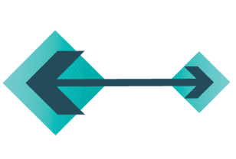
gRPC
What is it, and why should we use it?

Slide 55
gRPC
“Google” Remote Procedure Call
Uses HTTP/2 protocol to transport binary messages (inc. TLS)
Focused on high performance
Relies on “Protocol Buffers” (aka Protobuf) to defined the contract between end points
Multi-language support (C# client can call a Ruby service)
Frequently used as a method of service to service communication
Complex use of HTTP/ 2 prohibits use of gRPC in browser-based apps (would require a proxy)
C# Client
Ruby Service
.proto
gRPC stub
gRPC server
.proto
HTTP/2

Slide 56
Appendix

Slide 57
Platform Service Architecture
HTTP Request
Grpc Service (Synchronous - in)
HTTP Client (Synchronous - out)
HTTP Response
HTTP Request
Controller (Synchronous - in)
Msg. Publisher (Asynchronous - out)
HTTP Response
Publish to
Message Bus
DTOs
Repository
Mapped
Read/
Write
Models
DB Context
SQL Sever DB

Slide 58
Combined Service Architecture
Grpc Service (Synchronous - in)
Grpc Client (Synchronous - out)
HTTP Request
HTTP Request
Controller (Synchronous - in)
HTTP Client (Synchronous - out)
HTTP Response
HTTP Response
Msg. Subscriber (Asynchronous - in)
Msg. Publisher (Asynchronous - out)
Received from
Message Bus
Publish to
Message Bus
DTOs
Repository
Mapped
Read/
Write
Models
DB Context
SQL Sever DB

Slide 59
Kubernetes Architecture
Cluster
Node
Node Port
Pod
Pod
Pod
3xxxx
80
Platform
Service
Container
Platform SQL Server
Container
RabbitMQ
Container
80
666
1433
5672
15672
80
666
1433
5672
15672
Cluster IP
Cluster IP
Cluster IP
Pod
Pod
Ingress Nginx
Container
Command Service
Container
Ingress Nginx
Load Balancer
Persistent Volume Claim
80
80
80
80
Cluster IP
Kubernetes (Docker Desktop)
Container Runtime (Docker)
Operating System (Windows 10 with WSL2)
Hardware (PC)

Slide 60
Solution Architecture
Internal Microservices Domain
Platform
Service
SQL
Server
REST API
Http
Grpc
Pub.
“API Gateway”
RabbitMQ Message Bus
Grpc
Sub.
Command
Service
InMem
Db
REST API

Slide 61
Moving Forward
Introduction of HTTPS / TLS
Revisit Event Processor / Eventing
More elaborate use-case
Service Discovery

Slide 62
Thank You!

